Slide 1
THE 2nd B SAYS
NO HATE SPEECH!
FOR A DIFFERENT INTERNET

Slide 2
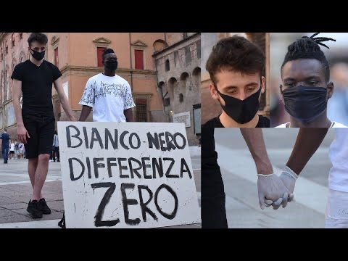
BLACK OR WHITE ZERO DIFFERENCE
~Zakaria

Slide 3
MOTIVATION FOR CHOOSING THE IMAGE
I chose this image because it represents a project brought to the web by influencers who wanted to deal with a very sensitive topic, racism.
In the image I chose, the two boys (with different skin colors) go around Bologna hand by hand (obviously with gloves and a mask for covid reasons) as a sign of equality and friendship despite their differences in origin, origin and colour.
In addition to a protest in the square with billboards and a couple of events taken to youtube, they also decided to create a very "ironic" song on youtube which, if read between the lines, gives a strong message.

Slide 4
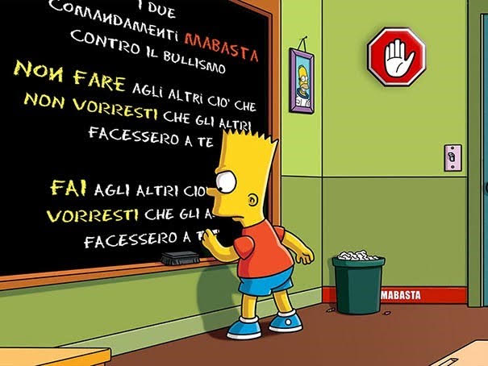
Serene

Slide 5
I chose this image because in my opinion two sentences are written that are greatly underestimated and of which not everyone attaches much importance.
Serene

Slide 7
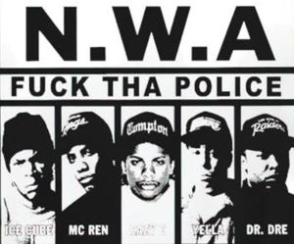
Song about racism
https://youtu.be/qZuxPKUVGiw
-Bright

Slide 8
Motivation for the choice of the song
I chose this song (somewhat violent and hate-inciting) because it was done as a protest against the brutal ways in which the American police caught and unjustly tried African Americans.

Slide 9
I chose this photo because it gives advice on how to deal with bad times.

Slide 10
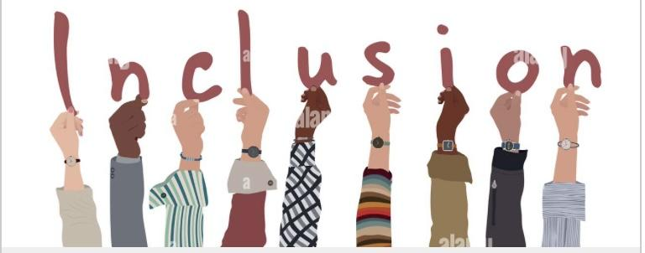
WE ARE ALL EQUAL

Slide 11
Motivation for choosing the image
I chose this image because it makes me understand that even if we are of different color or different ethnicity we are all the same and we must include no difference in color ethnicity religion because we are all the same in a single society
~Philip

Slide 12
Michael videos
https://vm.tiktok.com/ZML3DTnCU/?k1

Slide 13
Motivation of the video Michael
I too have been training for 2 months now and many people keep telling me "but you don't do anything where are the muscles / abs ???" In fact I chose this video because in everything you do you always have to put your own without letting other people's judgments get you down.

Slide 14
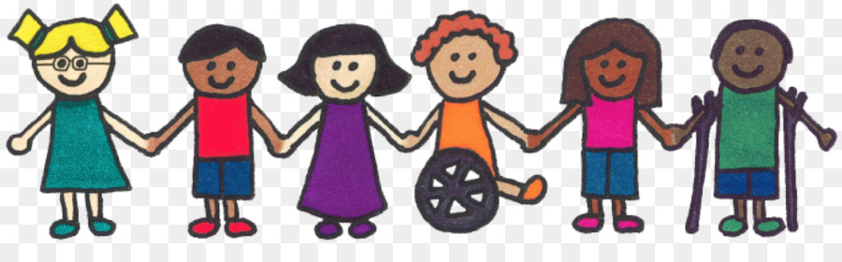
Gianmarco photo
I chose this image because I don't understand how children can get along with children of different ethnicities and adults don't.

Slide 16
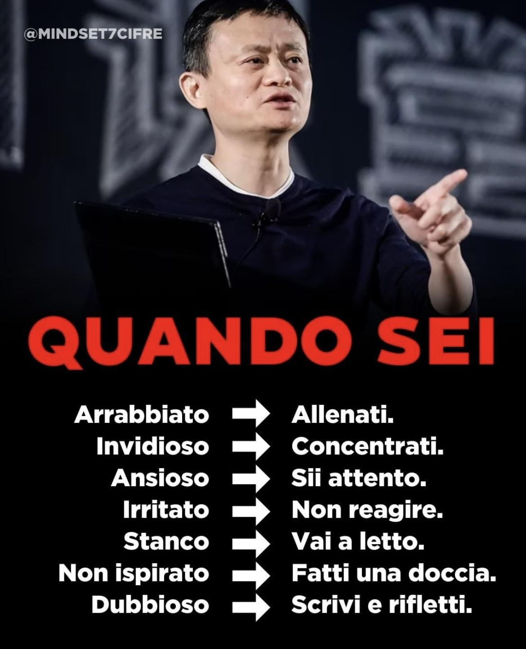
~sara

Slide 17
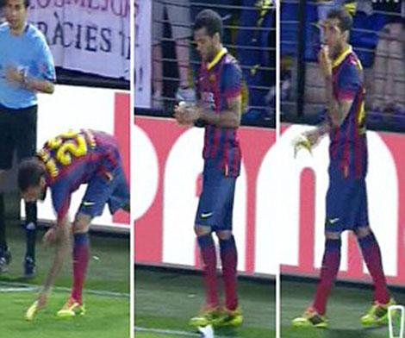
RACISM IN FOOTBALL. Nicholas
https://youtu.be/LaV7YJSt28I
I chose this video because these bad episodes happen in sports and football and should be deleted.

Slide 18
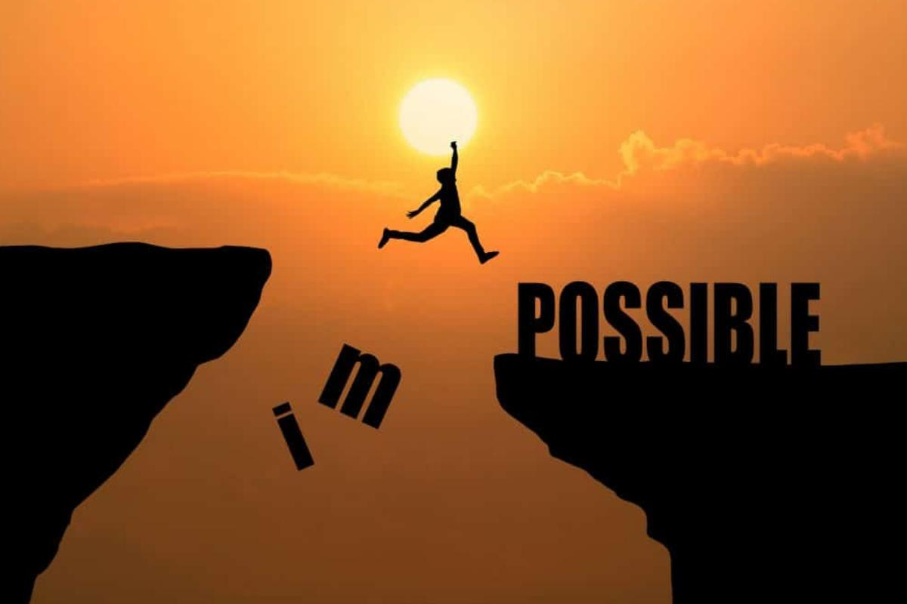
EVERYTHING IS POSSIBLE, ONLY IF YOU WANT
~Jacqueline

Slide 19
MOTIVATION OF THE CHOSEN IMAGE
I chose this image because every person can easily overcome their obstacles if they commit themselves.
~Jacqueline

Slide 20
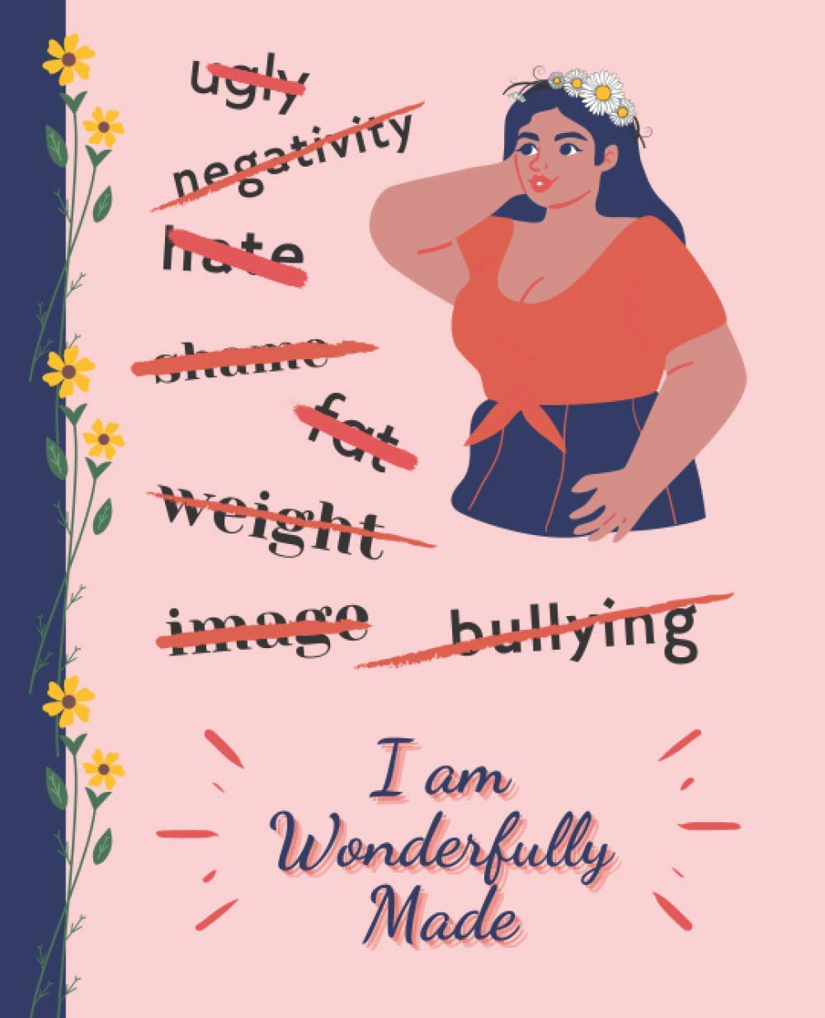
~White

Slide 21
I chose this image because I think it's not fair for others to criticize who we are.
Each of us has a characteristic that distinguishes us from everyone else and that's why we shouldn't speak ill of each other.
~White

Slide 22
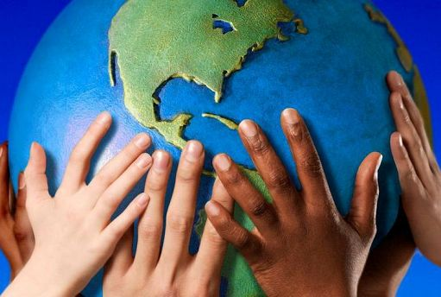
NO TO RACISM
~ Francesca

Slide 23
NO TO RACISM
I chose this image because it makes us understand that racism is wrong and that the only race is the human one, precisely because we all live on earth and therefore we are all equal without distinction.
~ Francesca

Slide 24

Sara P.

Slide 25
Motivation
I chose this image because there is still a lot of homophobia, every day we hear about people who are discriminated against just because they like the same sex, with this image we try to normalize homosexuality…
Sara P.

Slide 26
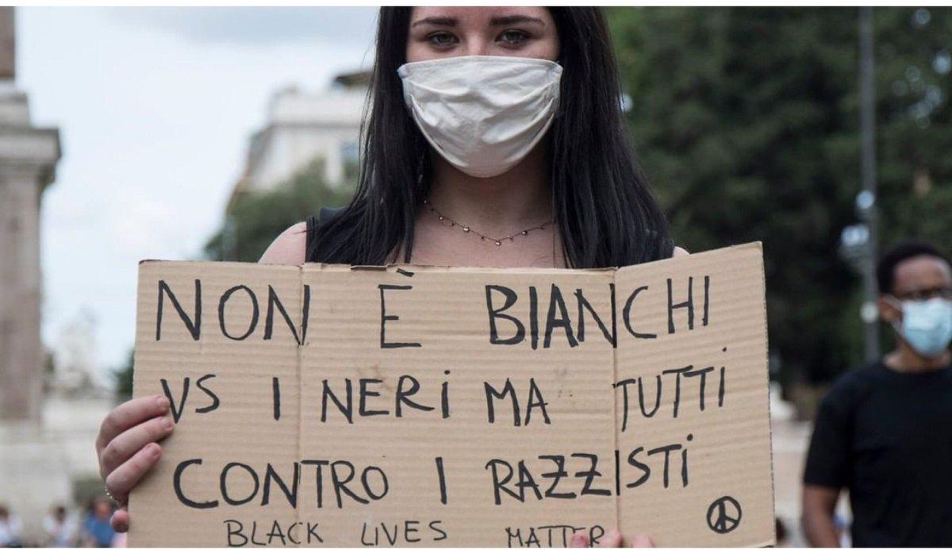

Slide 27
IMAGE MOTIVATION
I chose this image because in my opinion ALL of us ARE THE SAME, and we don't need to make any kind of distinction.
Each of us is different from the others and this is what makes us special from the others.
We all have to fight for it.
ALISHBA

Slide 28
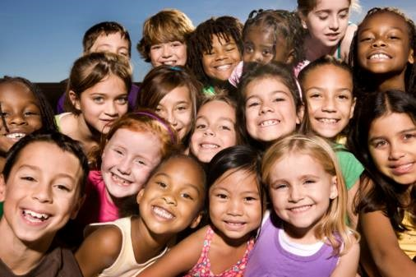

Slide 29
IMAGE MOTIVATION
I chose this image to show how we can all be happy and united together despite being different aesthetically.
CAROLAY

Slide 30


Slide 31
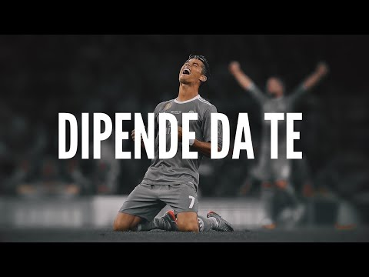
MOTIVATIONAL VIDEO
Philip Sannino

Slide 32
IMAGE MOTIVATION
I chose this image because in my opinion bullying and cyber bullying are very bad actions that must be fought in order not to spread them in schools
John

Slide 33
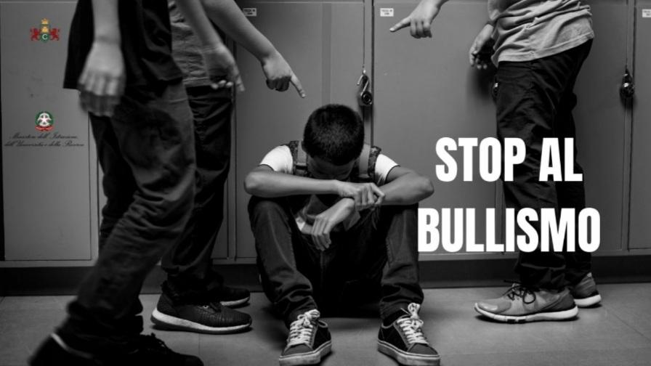

Slide 34
Image motivation
I chose this image because using violence is never good
David

